Slide 1
Zipit Bluetooth Serial mod. Steve Adolph
Goal: Enable portable internet connectivity for a Tandy 200 using a Zipit Z2
Tandy200 ←RS-232 bluetooth → Zipit Z2 ←→ internet
Approach: Add internal bluetooth serial adapter to the Zipit Z2
Use RN-42 from Sparkfun: enables serial over bluetooth
Tandy 200 has a matching bluetooth adapter
Minimal impact on look/feel of Zipit

Slide 2
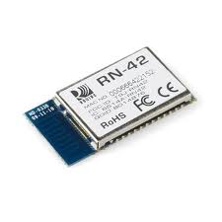
Internal Connections
RN-42: RS-232 + flow control
TxD, RxD, RTS, CTS, +3.3V, GND
Zipit Z2: ttyS1 is assigned to the “BT” serial port
3 signals on edge connector, 1 on PCB
(backside of Z2 LCD screen)
top
_________________________________________
| 36-pin connector . |
---------|_________________________________________|------- DC [O]
|||||||||||||||||| ||||||||||||||||||
bottom 36 19 18 1 (ext. +5VDC)
Connector Pin # Connected To Function Use
------------------------------------------------------------------
31 CPU C17 GPIO (45) BTRTS
36 CPU A20 GPIO (44) BTCTS
7 CPU D20 GPIO (42) BTRXD
- CPU B21 GPIO (43) BTTXD (connect at smd pad on board)

Slide 3
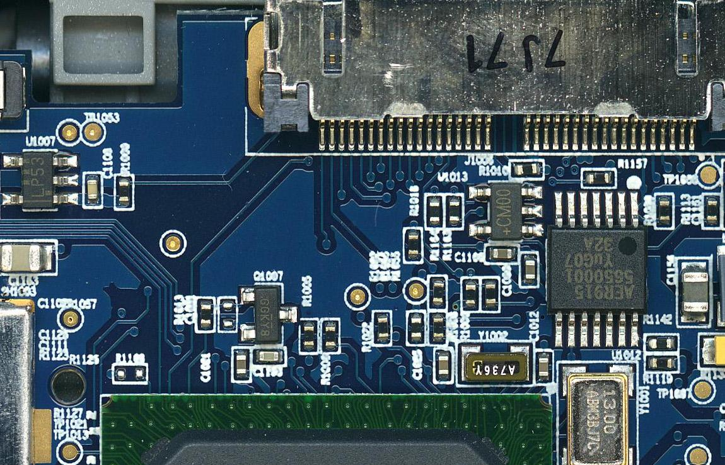
Serial port connections
CTS
RTS
RxD
TxD

Slide 4
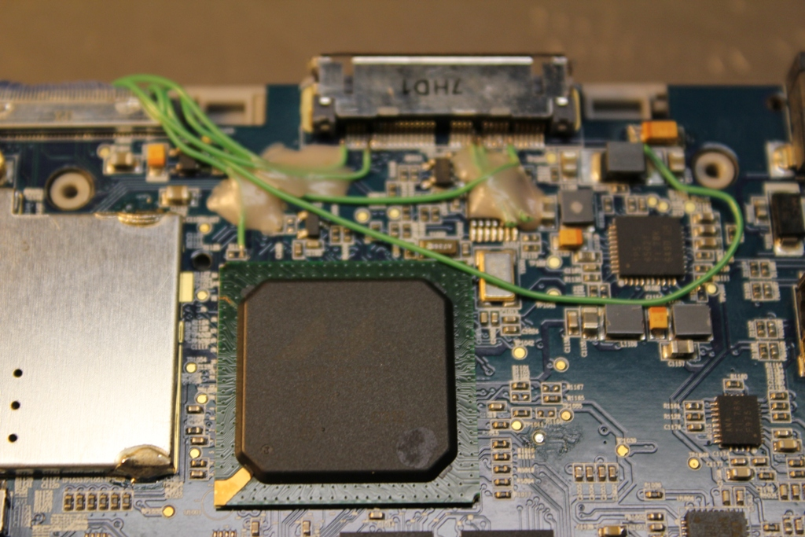
Wired up
3.3V

Slide 5
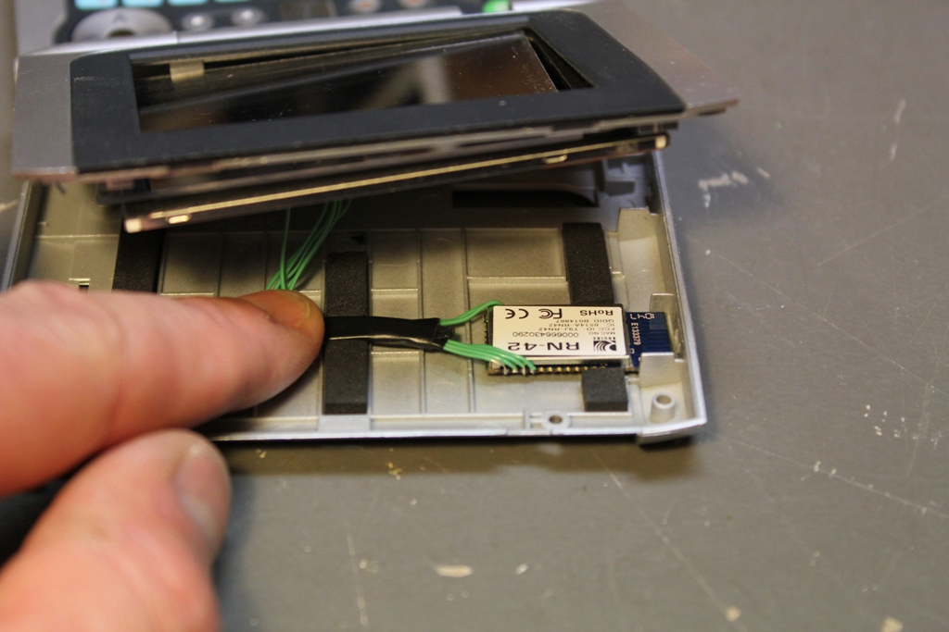
RN-42 placement

Slide 6
Comments
RN-42 fits snugly in the lcd cover, and there is no height problem.
I notched the foam to make room for RN-42, ad the wires.
Soldering was very tricky. I used a microscope and a third hand vice.
Adding LEDs for status would be a possible also.

